Slide 1
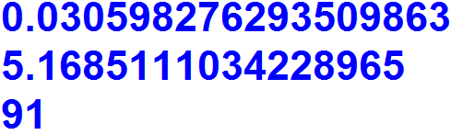
1.
Get a random float number between 0 and 1 and print it.
Get a random float number between 5 and 22 and print it.
Get a random integer number between 19 and 94 and print it.
Output

Slide 2
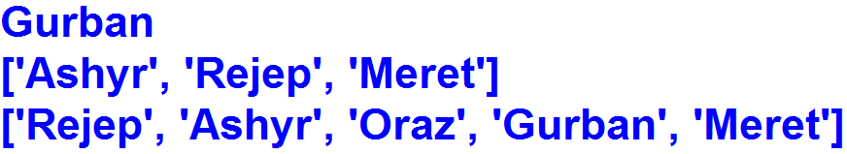
2. Create a list and its items: "Rejep", "Meret", "Oraz", "Gurban", "Ashyr“
Select a single, random element from the List and print it.
Randomly select a specified number of unique elements from the List and print it.
Randomly reorder (or permute) the elements of a list in place and print List.
Output

Slide 3
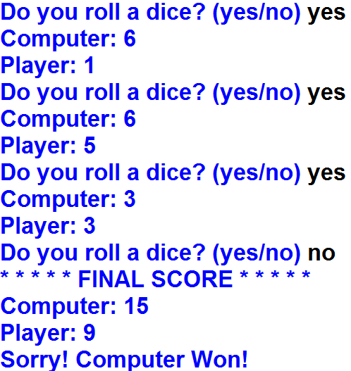
3. Roll a Dice Game
Output

Slide 4
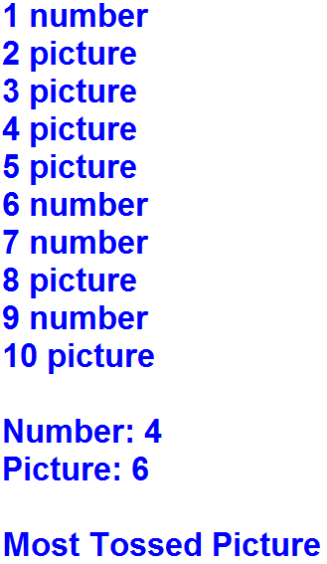

4. Toss a Coin Game
Output

Slide 5
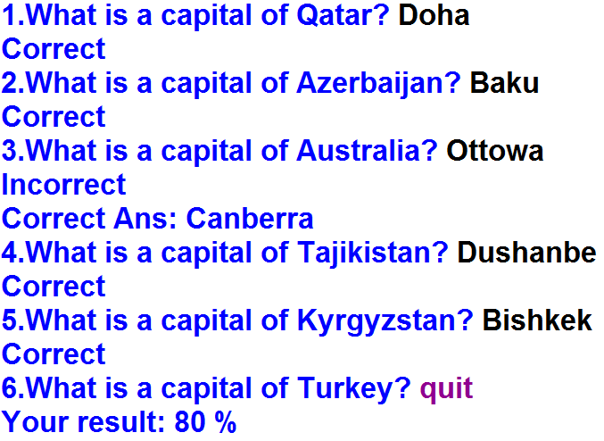
5. Country Capitals Game
Output

Slide 6
Country = {"Turkey" : "Ankara",
"Kazakhstan" : "Astana",
"Azerbaijan" : "Baku",
"Iraq" : "Baghdad",
"China" : "Beijing",
"Germany" : "Berlin",
"Kyrgyzstan" : "Bishkek",
"Australia" : "Canberra",
"Qatar" : "Doha",
"Tajikistan" : "Dushanbe",
"Pakistan" : "Islamabad",
"Afghanistan" : "Kabul",
"Spain" : "Madrid",
"Belarus" : "Minsk",
"Russia" : "Moscow",
"Canada" : "Ottawa",
"France" : "Paris",
"Italy" : "Rome",
"Uzbekistan" : "Tashkent",
"Japan" : "Tokyo" }

